Slide 1
"Unit 2: "For Live Session"
Chad Madding

Slide 2
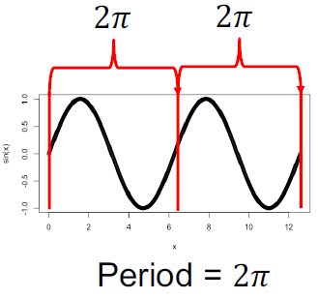
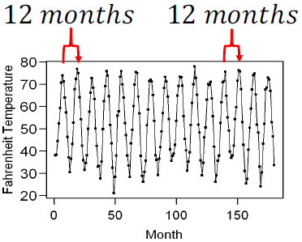
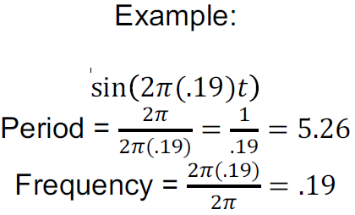
A brief reflection of thoughts and key takeaways – Week 2
This unit started off with a review of Sine and Cosine and included Phase Shift information:
Sin(t)
Period = 2𝜋 𝚫 = 𝜋 sin (𝑡 + 𝜋) Delta is the phase shift
Same in Cos(t)
Spectral Analysis: Analysis of Periodicities in the Data (Periodic and Psuedo-periodic)
Periodic functions - f (x) is periodic function with period p if p is the smallest value such that f (x) = f (x + kp)
for all x and integer k.
Psuedo-periodic data - Data are pseudo-periodic with period p if p is the smallest value such that a cycle
appears to repeat itself.
You can have non-periodic data called Aperiodic
where no p exist.
Period and Frequency of Sin and Cos:
Period = 2𝜋/B & Frequency = B/2𝜋 The main Idea is that If we can discover the
frequency content of a set of data (or lack thereof), then we can
better understand the process generating the data.
We went on to look at the Fourier Series “Non-cyclic type” functions can be expressed as a linear combination of sines
and cosines.
Spectral Analysis - The decomposition of functions (usually depending on time) into a sum of
sine and cosine terms.
Spectral Density - tool to identify the frequency content of a time series (if you know the AC (𝜌k) you can calculate the spectral density S(f) and vice versa. These are called Fourier transform pairs.
Example: Pseudoperiod = 12 months eak in the spectral Peek in the S. density at .083
Frequency = .0833 The Parzen window –
Smoothed Spectral Estimates

Slide 3
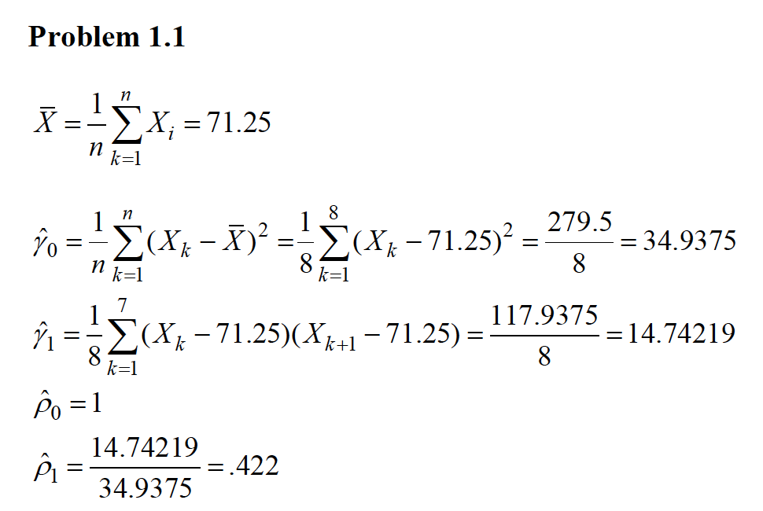
Questions on information – Week 2
I am having a tough time grasping gamma hat.
I have done the excel work and kind of get the math but I am needing to see how lambda works visually and in the bigger since of time series.
What is a simple definition of gamma in the below solution.
I got all the right answers but for me I need to see how all the parts work before the concept will stick.
Thanks for taking the time,
Chad

